Slide 1
Foundations of Complex Software Architectures and Styles
Damian A. Tamburri, Ph.D.
damianandrew.tamburri@polimi.it
dtamburri@acm.org

Slide 2
Advanced Software design and architectures: Architecture Styles

Slide 3
Architectural styles (1/2)
Certain design choices regularly result in solutions with superior properties
Compared to other possible alternatives, given solutions tend to be more elegant, effective, efficient, dependable, evolvable, scalable, …
An architectural style [Taylor, Medvidovic, Dashofy 2008] is a named collection of architectural decisions that
Are applicable in a given development context
Constrain architectural design decisions that are specific to a particular system within that context
Elicit beneficial qualities in each resulting system
Notes:
3

Slide 4
Architectural styles (2/2)
A primary way of characterizing lessons from experience in software system design
Reflect less domain specificity than design patterns
Useful in determining everything from subroutine structure to top-level application structure
Many styles exist…
Notes:
4

Slide 5
Basic properties of styles
A vocabulary of design elements
Component and connector types; data elements
E.g., pipes, filters, objects, servers
A set of configuration rules
Topological constraints that determine allowed compositions of elements
E.g., a component may be connected to at most two other components
A semantic interpretation
Compositions of design elements have well-defined meanings
Possible analyses of systems built with a given style
Notes:
5

Slide 6
Benefits of using styles
Design reuse
Well-understood solutions applied to new problems
Code reuse
Shared implementations of invariant aspects of a style
Understandability of system organization
A phrase such as “client-server” conveys a lot of information
Interoperability
Supported by style standardization
Style-specific analyses
Enabled by the constrained design space
Visualizations
Style-specific depictions matching engineers’ mental models
Notes:
6

Slide 7
Some common styles
Language-influenced
Main program and subroutines
Object-oriented
Layered
Virtual machines
Client-server
Data-flow
Pipe and filter
Shared memory
Blackboard
Rule based
Interpreter
Mobile code
Implicit invocation
Event-based
Publish-subscribe
Peer-to-peer
Notes:
7

Slide 8
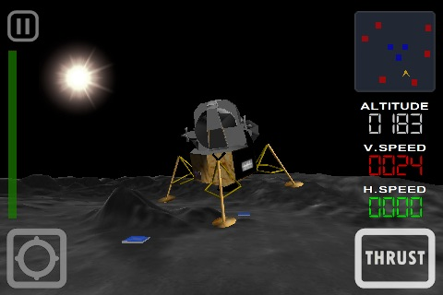
Running example: The lunar lander (LL) game
A simple computer game that first appeared in the 1960’s
Simple concept:
You (the pilot) control the descent rate of the Apollo-era Lunar Lander
Throttle setting controls descent engine
Limited fuel
Initial altitude and speed preset
You win if you land with a descent rate of < 5 fps (whether there’s fuel left or not)

Slide 9
Components and connectors Style
Components
clients
servers
filters
layers
databases
...
Connectors
procedure call
event broadcast
database protocols
pipes
...

Slide 10
Main program and subroutines Style
Decomposition based upon separation of functional processing steps
Components: main program and subroutines
Topology: static hierarchical organization of components
Qualities yielded: modularity
Typically used for small programs
Fails to scale, inadequate attention to data structure

Slide 11
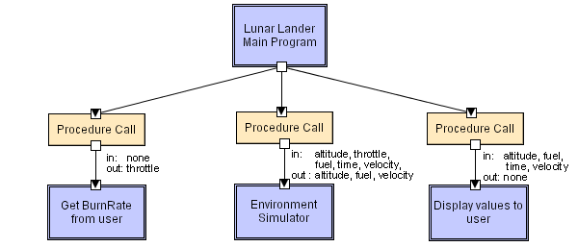
Main program and subroutines with LL
Software Architecture: Foundations, Theory, and Practice; Richard N. Taylor, Nenad Medvidovic, and Eric M. Dashofy; © 2008 John Wiley & Sons, Inc. Reprinted with permission.
Notes:
11
Main program displays greetings and instructions, then enters a loop in which it calls the three subroutines in turn.

Slide 12
Object-oriented style
Components are objects
Data and associated operations
Connectors are messages and method invocations
Style invariants
Objects are responsible for their internal representation
Internal representation is hidden from other objects
Advantages
“Infinite malleability” of object internals
System decomposition into sets of interacting agents
Disadvantages
Objects must know identities of servers
Side effects in object method invocations
Notes:
12

Slide 13
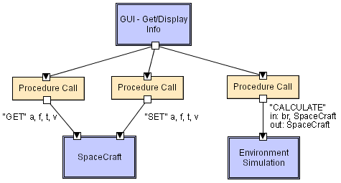
Object-orientation with LL
Software Architecture: Foundations, Theory, and Practice; Richard N. Taylor, Nenad Medvidovic, and Eric M. Dashofy; © 2008 John Wiley & Sons, Inc. Reprinted with permission.
Notes:
13

Slide 14
Client-Server style
Components are clients and servers
Servers do not know the number or identities of clients
Clients know the server’s identity
Connectors are RPC-based network interaction protocols
Note: Client-Server is merely a conceptual organization of functionality
may not necessarily be applied in a distributed setting!
Notes:
14

Slide 15
Client/Server
The best known and most used architectural style for distributed applications

Slide 16
Client/Server
Client & server are different processes with well-defined interface
Accessible only through interface
Client & server may be defined by a set of hw/sw modules
Client & server play different roles
Server invoked to provide one of a set of services
Client uses the provided services and initiates communication
Comunication through messages or through remote invocations

Slide 17
C/S: a general scheme
request
Client
Server
Host A
response
Host B

Slide 18
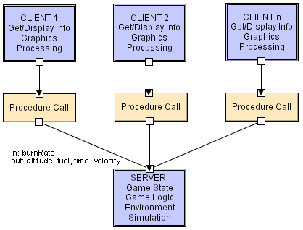
Client-Server with LL
Software Architecture: Foundations, Theory, and Practice; Richard N. Taylor, Nenad Medvidovic, and Eric M. Dashofy; © 2008 John Wiley & Sons, Inc. Reprinted with permission.
Notes:
18

Slide 19



Client servers and tiers
Distr.
Presentation
Remote
presentation
Distr.
logic
Remote
data access
Distr. database
Client
GUI
GUI
GUI
GUI
GUI
Applic1
Applic.
Applic.
Network
Network
Network
Data
GUI
Network
Server
Applic.
Applic.
Applic2
Network
Data
Data
Data
Data
Data
Notes:
19
Distributed presentation
"intelligence" in server, client only cares about presentation
es: pure HTML form cannot do input data validation
Vnc: remote access software for desktop and mobile platforms
Remote presentation
client in charge of all presentation issues
Distributed logic
application logic partly decentralized in client
Remote data access
client in charge of both presentation and logic
server used only to access data, typically through SQL interface
Distributed DB
data management partly done by client and partly by server

Slide 20


Adding more tiers
Typical scheme
Alternative schemes
Client
GUI
GUI
GUI
GUI
Appl.
programs
Network
Appl.
programs
Network
Network
Network
Appl.
programs
Appl.
programs
Appl.
programs
Server(s)
…
Appl.
programs
Network
Network
Network
Network
Appl.
programs
Appl.
programs
Data
Data
Data
Data
Notes:
20

Slide 21

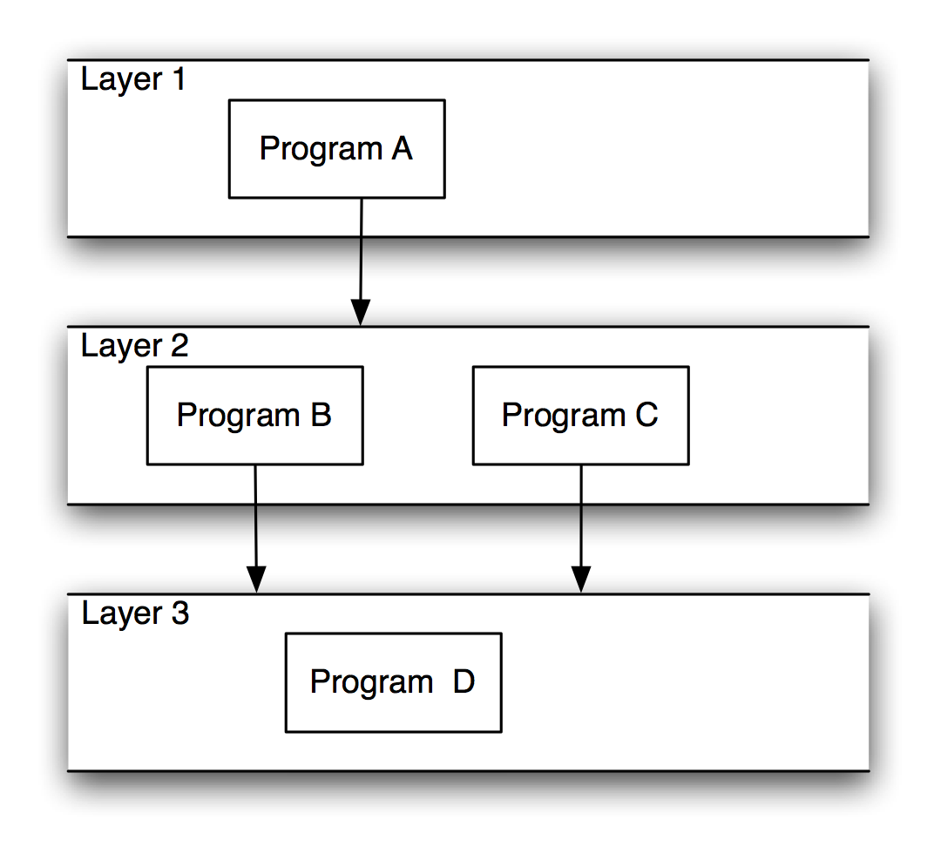
Layered style (1/2)
Hierarchical system organization
Each layer acts as a
Server: service provider to layers “above”
Client: service consumer of layer(s) “below”
Topology:
Sort of “multi-level client-server”
Each layer exposes an interface (API) to be used by layers above
Connectors are protocols of layer interaction
Example: operating systems
Virtual machine style results from fully opaque layers
Notes:
21

Slide 22
Layered style
The system is organized through abstraction levels, as a hierarchy of abstract machines
Hierarchy is given by the USE relation
A
A
the onion-ring
structure
B, C
B
C
D, E
D
E

Slide 23
Well-known layered systems: An Operating System

Slide 24
Layered style (2/2)
Advantages
Increasing abstraction levels
Evolvability
Reuse: changes in a layer (should) affect at most the adjacent two layers
Different implementations of layer are allowed as long as interface is preserved
Standardized layer interfaces for libraries and frameworks
Disadvantages
Not universally applicable
Performance
24
Notes:
24

Slide 25
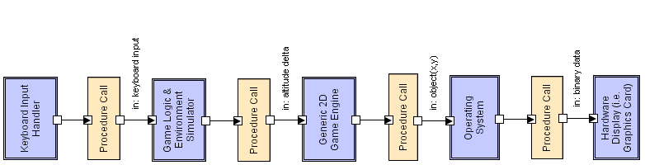
Layered style with LL
Software Architecture: Foundations, Theory, and Practice; Richard N. Taylor, Nenad Medvidovic, and Eric M. Dashofy; © 2008 John Wiley & Sons, Inc. Reprinted with permission.
Notes:
25

Slide 26
Can you make an extremely known example?

Slide 27
Can you make an extremely known example?
The INTERNET! Of course…

Slide 28
Well-known layered systems: The OSI and TCP/IP models

Slide 29
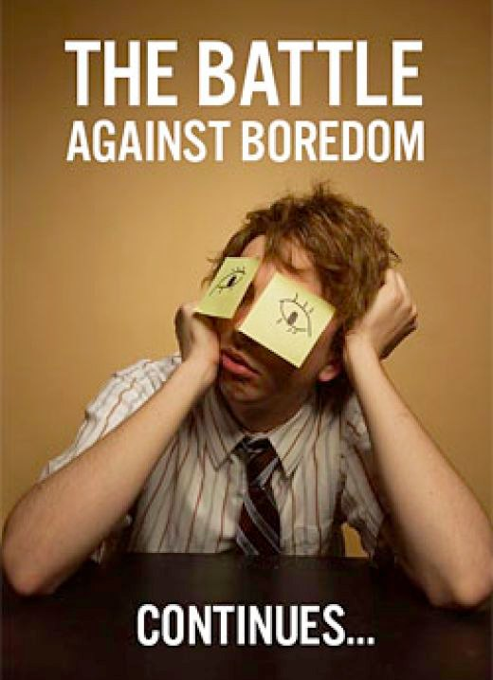
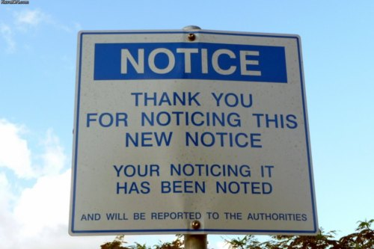
Bored yet?
10 min Break?

Slide 30
Publish-Subscribe (1/2)
Summary:
Subscribers register/deregister to receive specific messages or specific content
Publishers broadcast messages to subscribers either synchronously or asynchronously
Components: publishers and subscribers
Connectors:
Typically a network protocol is required
Content-based subscription requires sophisticated connectors
Data elements: subscriptions, notifications, published information
Topology: subscribers connect to publishers either directly or may receive notifications via a network protocol from intermediaries
Qualities: with very low-coupling of components
Widely adopted for user interfaces
Notes:
30

Slide 31
Publish-Subscribe (2/2)
Publisher
Subscriber A
Broker
Subscriber B
Subscriber C
Notes:
31

Slide 32
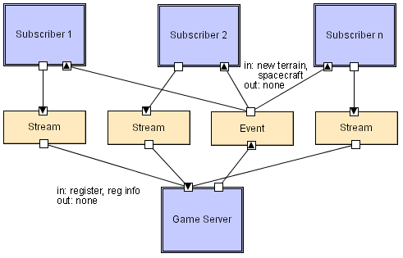
Publish-Subscribe with LL
Software Architecture: Foundations, Theory, and Practice; Richard N. Taylor, Nenad Medvidovic, and Eric M. Dashofy; © 2008 John Wiley & Sons, Inc. Reprinted with permission.
Notes:
32

Slide 33


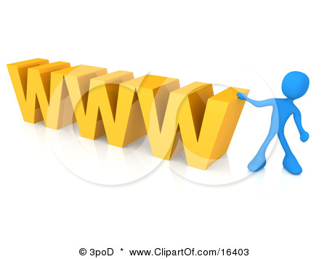

Client-Server vs. Publish/Subscribe
Client-server
Many-to-one
Typically synchronous
Servers’ identity is known at the client side
Connection-oriented
Publish/Subscribe
Many-to-many
Typically asynchronous
Components’ identity is unknown
Connection-less
Notes:
33

Slide 34
Event-based style
Independent components asynchronously emit and receive events communicated over event buses
Components: independent, concurrent event generators and/or consumers (no fixed roles as in publish/subscribe)
Connectors: event buses (at least one)
Data elements: events – data sent as a first-class entity over the event bus
Topology: Components communicate with the event buses, not directly to each other
Variants: Component communication with the event bus may either be push or pull based
Highly scalable, easy to evolve, effective for highly distributed applications
Notes:
34

Slide 35
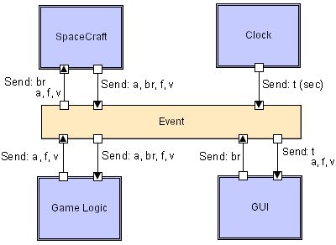
Event-based with LL
Software Architecture: Foundations, Theory, and Practice; Richard N. Taylor, Nenad Medvidovic, and Eric M. Dashofy; © 2008 John Wiley & Sons, Inc. Reprinted with permission.
Notes:
35

Slide 36
Main characteristics
Asynchrony
send and forget
Reactive
computation driven by receipt of message
Location/identity abstraction
destination determined by receiver, not sender
Loose coupling
senders/receivers added without reconfiguration
one-to-many, many-to-one, many-to-many

Slide 37
Features
Increasingly used for modern software
Easy integration strategies
Easy addition/deletion of components
Potential scalability problems
Ordering of events

Slide 38
Repository-based systems
Components communicate only through a repository
Components: independent, concurrent even generators and/or consumers of information from repository
Connectors: the repository
Data elements: tuples stored/retrieved from the repository
Topology: Components communicate through the repository, not directly to each other
Repository is persistent (as opposed to events that are transient)
Several action can be grouped in a transaction
Notes:
38

Slide 39
Repository-based systems
Components communicate only through a repository
Repository
Comp1
Comp2
Comp3

Slide 40




Peer-to-Peer style (1/2)
State and behavior are distributed among peers which can act as either clients or servers
Peers: independent components, having their own state and control thread
Connectors: network protocols, often custom
Data elements: network messages
Notes:
40

Slide 41
Peer-to-Peer style (2/2)
Topology: network (may have redundant connections between peers); can vary arbitrarily and dynamically
Supports decentralized computing with flow of control and resources distributed among peers
Aims at being highly robust in the face of failure of any given node
Scalable in terms of access to resources and computing power
Notes:
41

Slide 42
Peer-to-Peer architectures
P2P
No asymmetry as in CS
components interact as peers
request/reply bidirectional interaction style among peers
interaction may be initiated by either party
autonomous entities that share services to others

Slide 43
Advantages
Democratic Networking → Sharing! → ☺
Peer to peer storage
Cheaper Hw +sw
Natural Data-Redundancy
Small-world coop system
Distribution network

Slide 44
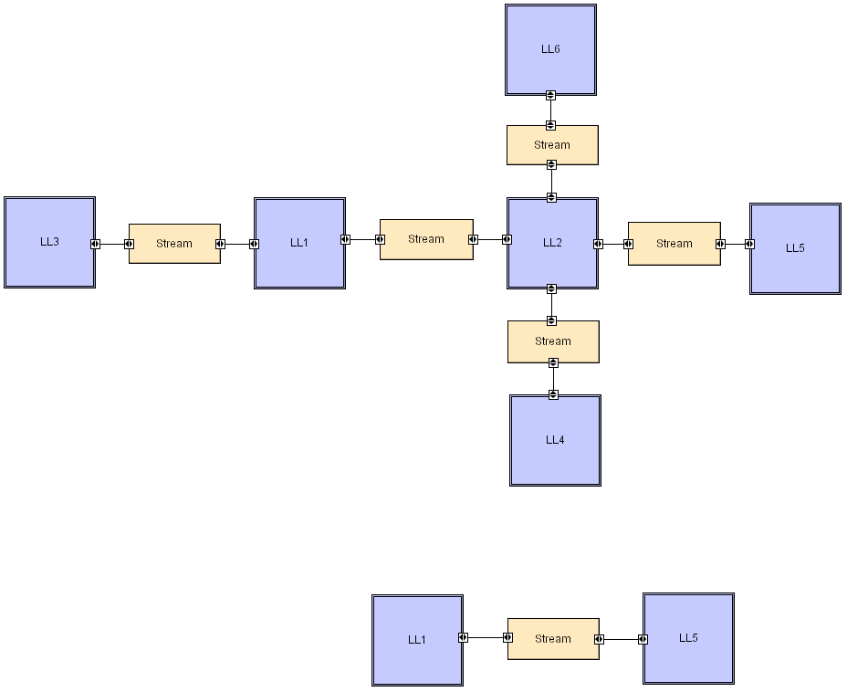
Peer-to-Peer with LL
Software Architecture: Foundations, Theory, and Practice; Richard N. Taylor, Nenad Medvidovic, and Eric M. Dashofy; © 2008 John Wiley & Sons, Inc. Reprinted with permission.
Notes:
44

Slide 45
Gnutella: a P2P middleware
An open source software providing support to bidirectional info transfer among peers
a peer communicates directly with a small number of friendly sites or with public Gnutella sites
Gnutella provides protocols for
discovery
information search and exchange

Slide 46
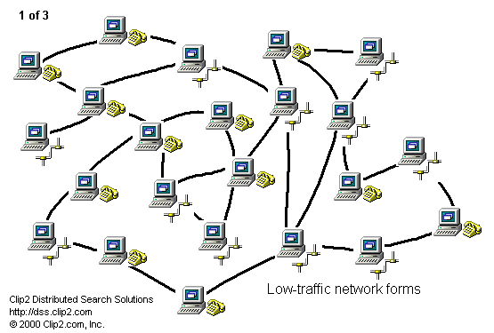
Gnutella: pure peer-to-peer
Gnutella servents
Msgs:
ping
pong
query
hit
push

Slide 47
Gnutella: Scalability Barriers
Mean Query Number (MQN) > 10/s [clip2.com]

Slide 48
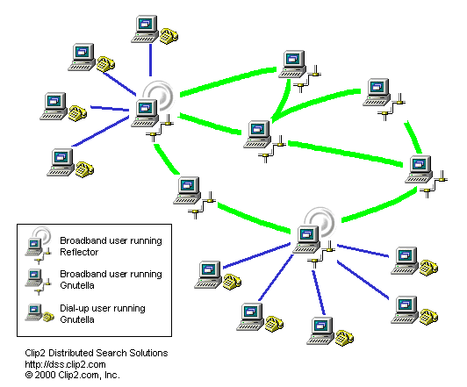
Gnutella: super peers

Slide 49
Rule-Based style
Knowledge base: a container of facts and rules
An inference engine parses user input and determines whether it is a fact/rule or a query
If it is a fact/rule, it adds this entry to the knowledge base
If it is a query, it queries the knowledge base for applicable rules and attempts to resolve the query
Notes:
49

Slide 50
Rule-Based Style (cont’d)
Components: user interface, inference engine, knowledge base
Connectors: components are tightly interconnected, with direct procedure calls and/or shared memory.
Data elements: facts and queries
Behavior of the application can be very easily modified through addition or deletion of rules from the knowledge base.
Caution: when a large number of rules are involved, understanding the interactions between multiple rules affected by the same facts can become very difficult
Notes:
50

Slide 51
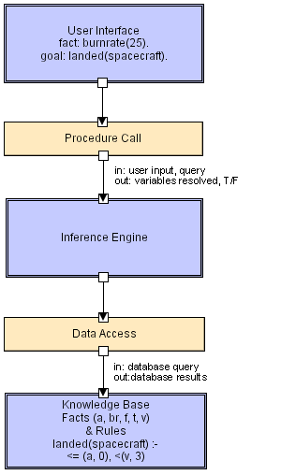
Rule Based with LL
Software Architecture: Foundations, Theory, and Practice; Richard N. Taylor, Nenad Medvidovic, and Eric M. Dashofy; © 2008 John Wiley & Sons, Inc. Reprinted with permission.
Notes:
51

Slide 52
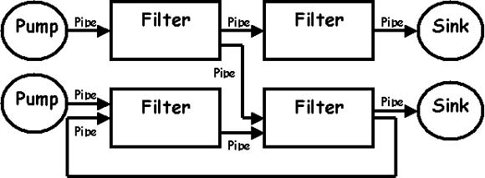
Pipe and filter style (1/2)
Components are filters
Transform input data streams into output data streams
Possibly incremental production of output
Connectors are pipes
Conduits for data streams
Style invariants
Filters are independent (no shared state)
Filter has no knowledge of up- or down-stream filters
Examples
UNIX shell
Distributed systems
Notes:
52

Slide 53
Pipe and filter style (2/2)
Variations
Pipelines: linear sequences of filters
Bounded pipes: limited amount of data on a pipe
Typed pipes: data strongly typed
Advantages
System behavior is a succession of component behaviors
Filter addition, replacement, and reuse
Possible to hook any two filters together
Certain analyses
Throughput, latency, deadlock
Concurrent execution
Disadvantages
Batch organization of processing
Interactive applications
Lowest common denominator on data transmission
Notes:
53

Slide 54
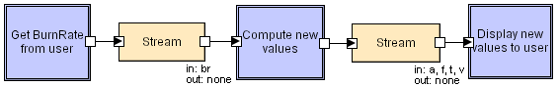
Pipe and filter with LL
Software Architecture: Foundations, Theory, and Practice; Richard N. Taylor, Nenad Medvidovic, and Eric M. Dashofy; © 2008 John Wiley & Sons, Inc. Reprinted with permission.
Notes:
54
GetBurnRate runs continuously on its own, prompting the user for a new burn rate.
In this design the “compute new values” determines how much time has passed. Could alternatively do that in the GetBurnRate filter. Would change semantics a bit.
ULTIMA SLIDE CORSO ITALIANO

Slide 55
Pipes&filter style
The “Unix” model
pipes
Filters get and put data on their
input and output pipes; they ignore
the existence (and identity) of other
filters.

Slide 56
Blackboard Style
Two kinds of components
Central data structure: blackboard
Components operating on the blackboard via well-defined APIs
System control is entirely driven by the blackboard state
Examples
Typically used for AI systems
Compiler architecture
Notes:
56

Slide 57
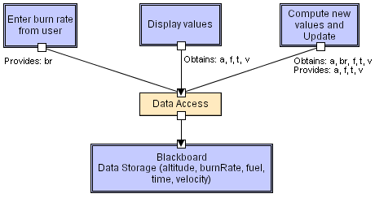
Blackboard LL
Software Architecture: Foundations, Theory, and Practice; Richard N. Taylor, Nenad Medvidovic, and Eric M. Dashofy; © 2008 John Wiley & Sons, Inc. Reprinted with permission.
Notes:
57

Slide 58
Service-oriented architecture Style (SOA)
Technically, similar to distributed objects
Services are runtime components
Services offer operations that can be invoked by external clients
A SOA-based system is obtained by assembling services
The way services are assembled is independent from the way they are implemented
They see each other only through their interface

Slide 59
Service-oriented architecture (SOA)
Service-oriented applications differ from traditional applications in three ways [http://www.plumtree.com/applications/ (just one of the first references obtained through a Google search)]:
They combine existing data and processes from enterprise systems with new shared services for greater return on assets;
They are assembled dynamically, incorporating new capabilities on-the-fly for greater adaptability; and
They are designed to be integrated into an enterprise-wide environment, so users can easily navigate between or search across applications, and services developed for one application can be re-used as-is in other applications. This results in enterprise-wide economies of scale.

Slide 60
Service-oriented architecture (SOA)
The SOA defines three agents
Service requestors: they request the execution of a service
Service providers: they offer services
Intermediaries (service brokers, meta information providers, service registries): they provide information (metadata) about other information/services
The interaction among these roles results in the execution of the following operations
Service description publication
Service discovery
Service binding

Slide 61
Roles and operations
Service
Description
Service
Registry
Find
Publish
Service
Requestor
Service
Provider
Service
Bind
Service
Description

Slide 62
Open issues
Security
Reliability of message exchange
Quality of Service
Service maintainability
Transaction management
Service composition
Services collaborate to offer a more advanced service

Slide 63
Middleware
Provides services to program a distributed system, as extensions of the operating system
It is a layer on top of the OS, used by applications

Slide 64
CORBA
Common Object Request Broker Architecture (CORBA) is an emerging open distributed object computing infrastructure standardized by the Object Management Group
www.omg.org

Slide 65
Overview of CORBA
CORBA shields applications from heterogeneous platform dependencies
e.g., languages, operating systems, networking protocols, hardware
It simplifies development of distributed applications by automating/encapsulating
Object location
Connection & memory mgmt.
Parameter (de)marshaling
Event & request demultiplexing
Error handling & fault tolerance
Object/server activation
Concurrency
Security
CORBA defines interfaces, not implementations

Slide 66
IDL
CORBA IDL specifies interfaces with operations
interfaces map to objects in programming languages (C++, Java, ...)
Operations in interfaces can be on local or remote objects
interface Foo {
void MyOp(in long arg);
};
class Foo : public virtual CORBA::Object {
virtual void MyOp( CORBA::Long arg);
};
IDL
C++

Slide 67
Jini
presence
announcement
LOOKUP PROCESS
JOIN PROCESS
Directory of
available
services
matching
object ref
service
registrar
client
service
template
JINI
enabled
service
service
item
(descriptor)
CLIENT JOINS

Slide 68
Shall we go home?
On Nov. 9th we will have our 1st project revision!
Prepare a presentation:
20 mins + questions
You will HAVE TO expose, at least:
(a) the architecture and organisational structure of the community and product;
(b) the properties and visible features of the architecture;
(c) the limitations and shortcomings of that product, how to install/interact with it;
You MAY want to use the concepts and notations we used up to this point;
Notes:
ARRIVED HERE ON OCT. 30

Slide 69
… (More) Advanced Architectural Styles: Cloud Computing & Cloud Patterns
http://www.cloudcomputingpatterns.org

Slide 70
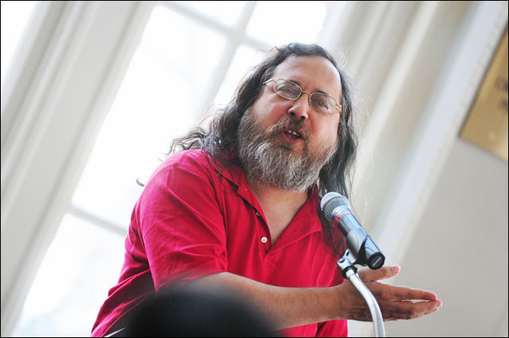

Cloud Disclaimers
Talk from Oracle CEO Larry Ellison
We’ve redefined Cloud Computing to include everything that we already do. I don’t understand what we would do differently other than change the wording of some of our ads.
Talk from Rich Stallman
It's stupidity. It's worse than stupidity: it's a marketing hype campaign. Somebody is saying this is inevitable – and whenever you hear somebody saying that, it's very likely to be a set of businesses campaigning to make it true.

Slide 71
Bored yet?
10 min Break?

Slide 72

Cloud Definitions
Definition from NIST (National Institute of Standards and Technology)
Cloud computing is a model for enabling convenient, on-demand network access to a shared pool of configurable computing resources (e.g., networks, servers, storage, applications, and services) that can be rapidly provisioned and released with minimal management effort or service provider interaction.
This cloud model promotes availability and is composed of five essential characteristics, three service models, and four deployment models.

Slide 73
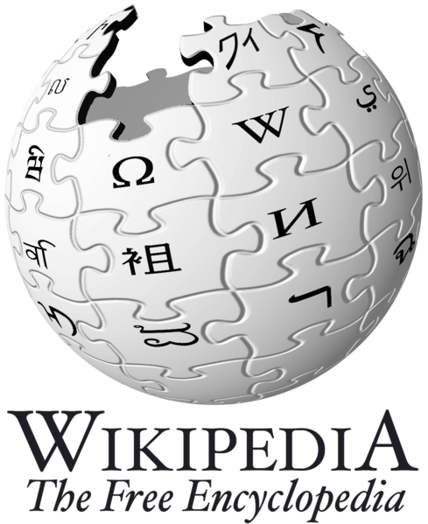
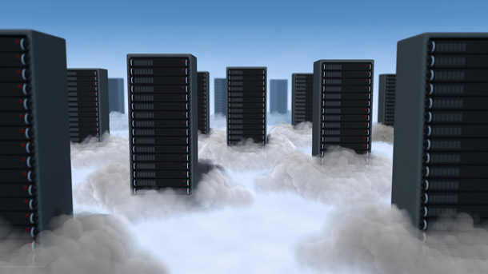
Cloud Definitions
Definition from Wikipedia
Cloud computing is Internet-based computing, whereby shared resources, software, and information are provided to computers and other devices on demand, like the electricity grid.
Cloud computing is a style of computing in which dynamically scalable and often virtualized resources are provided as a service over the Internet.

Slide 74
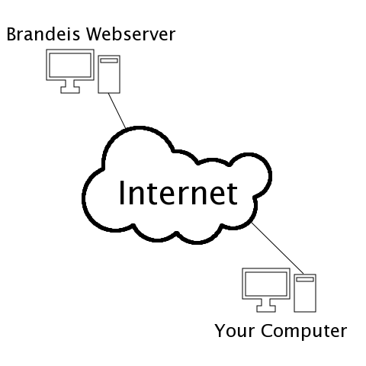
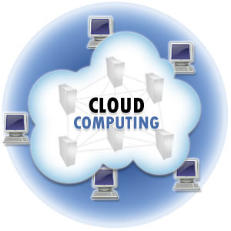
Cloud Definitions
Definition from Whatis.com
The name cloud computing was inspired by the cloud symbol that's often used to represent the Internet in flowcharts and diagrams. Cloud computing is a general term for anything that involves delivering hosted services over the Internet.

Slide 75

Cloud Definitions
Definition from Berkeley
Cloud Computing refers to both the applications delivered as services over the Internet and the hardware and systems software in the datacenters that provide those services.
The services themselves have long been referred to as Software as a Service (SaaS), so we use that term. The datacenter hardware and software is what we will call a Cloud.
When a Cloud is made available in a pay-as-you-go manner to the public…… The service being sold is Utility Computing.

Slide 76
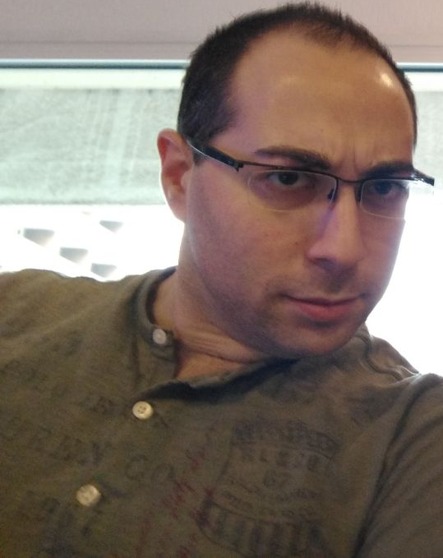
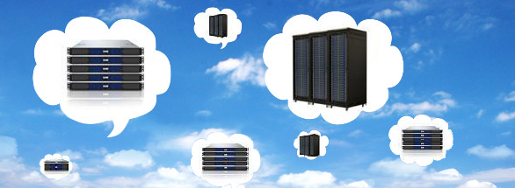
Cloud Definitions
Definition from Damian
A Cloud is a type of distributed system consisting of interconnected and virtualized computers dynamically provisioned and presented as one (or more) unified computing resource(s) based on service-level agreements established through negotiation between service providers and consumers.

Slide 77

Are you Confused??

Slide 78

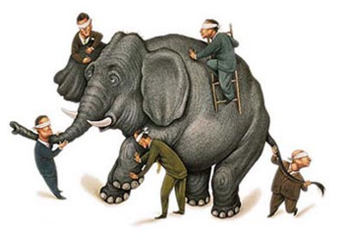
What is Cloud computing ?
Properties and characteristics

Slide 79

In My Humble Opinion
Cloud computing is a paradigm of computing, a new way of thinking about IT industry but not any specific technology.
Central ideas
Utility Computing
SOA - Service Oriented Architecture
SLA - Service Level Agreement
Properties and characteristics
High scalability and elasticity
High availability and reliability
High manageability and interoperability
High accessibility and portability
High performance and optimization
Enabling techniques
Hardware virtualization
Parallelized and distributed computing
Web services

Slide 80
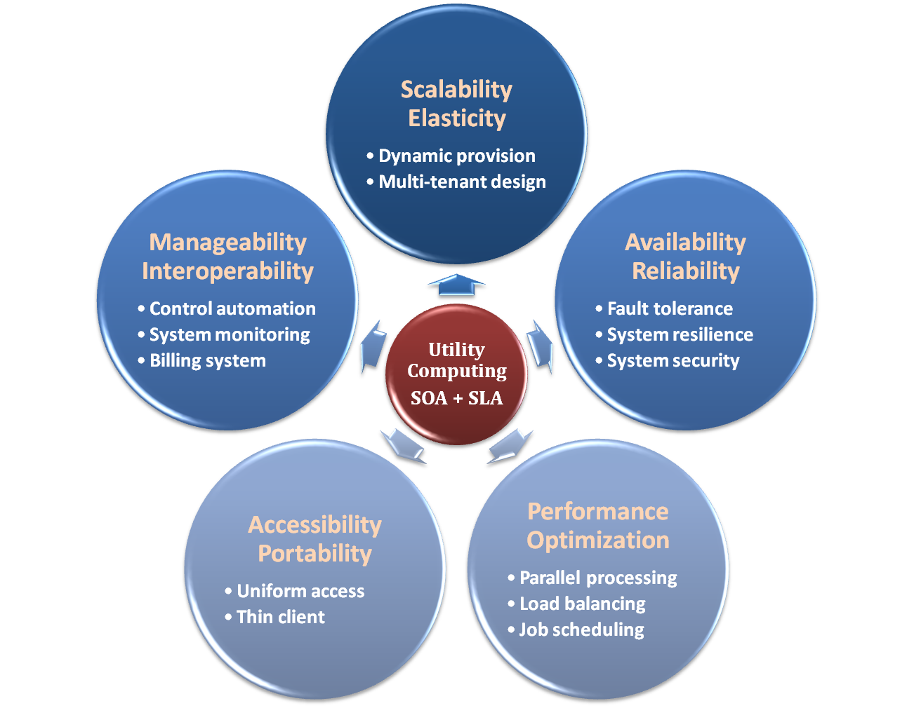

Properties and Characteristics

Slide 81

Central Ideas
Utility Computing SOA + SLA
Don’t tell me details!!
I DON’T CARE!!

Slide 82

Central Ideas
Utility Computing SOA + SLA
User Perspective:
Users do not care about how the works are done
Instead, they only concern about what they can get
Users do not care about what the provider actually did
Instead, they only concern about their quality of service
Users do not want to own the physical infrastructure
Instead, they only want to pay as many as they used
What dose user really care ?
They only care about their “Service”

Slide 83
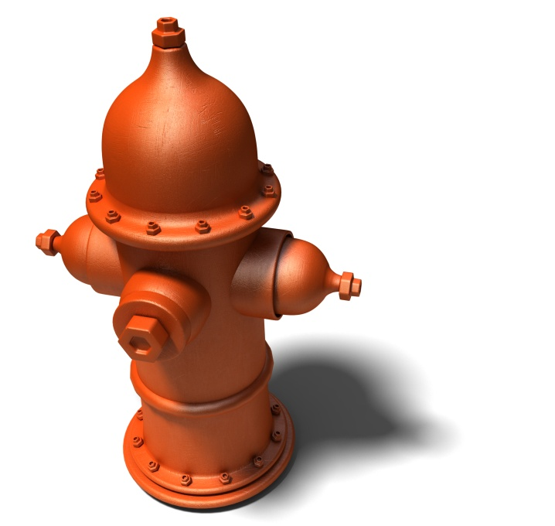
Utility Computing
Utility Computing SOA + SLA
One service provisioning model
Service provider makes computing resources and infrastructure management available to the customer as needed, and charges them for specific usage rather than a flat rate.
Like other types of on-demand computing , the utility model seeks to maximize the efficient use of resources and/or minimize associated costs.

Slide 84
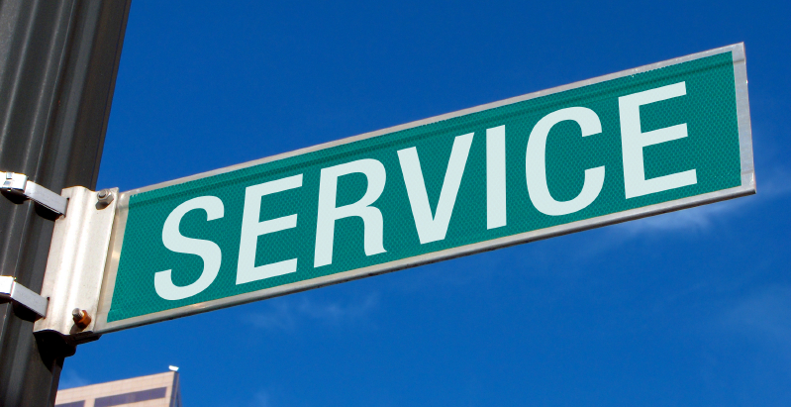
What Is Service?
Utility Computing SOA + SLA
Service is what you connect together using Web Services.
Service is the endpoint of a connection.
Functionalities of service :
A service should be well-defined
A service should be self-contained
A service should not depend on the context or state of other services.

Slide 85
What Is Web Service?
Utility Computing SOA + SLA
Definition :
Web service is self-describing and stateless modules that perform discrete units of work and are available over the network
Web service providers offer APIs that enable developers to exploit functionality over the Internet, rather than delivering full-blown applications
Web Services Description Language (WSDL) :
Expressed in XML which include both data type and messages
Four types of operations :
One-way - Messages sent without a reply required
Request & response - Sending and replying messages
Solicit response - A request for a response
Notification - Messages sent to multiple receivers

Slide 86
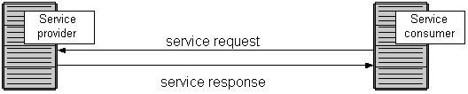
Service Oriented Architecture (Recall)
Utility Computing SOA + SLA
Definition
Service Oriented Architecture (SOA) is essentially a collection of services which communicate with each other
Contain a flexible set of design principles used during the phases of systems development and integration
Provide a loosely-integrated suite of services that can be used within multiple business domains
Approach
Usually implemented by Web Service model

Slide 87

Quality Of Service
Utility Computing SOA + SLA
Original definition
Quality of Service (QoS) is a set of technologies for managing network traffic in a cost effective manner to enhance user experiences for home and enterprise environments.
Now QoS becomes to a broad term that is used following areas :
Customer care evaluations
Technological evaluations

Slide 88
Quality Of Service
Utility Computing SOA + SLA
Customer care evaluations
QoS is usually measured in terms of issues that have a direct impact on the experience of the customer
Only issues that produce a negative effect on the goods and services received by the customer come under scrutiny
Technological evaluations
QoS has to do with the efficient operation of various systems
This can lead to adjusting procedures or adapting software programs and code to achieve the desired effect while making a more efficient use of available resources

Slide 89

Service Level Agreement
Utility Computing SOA + SLA
Definition
A service-level agreement (SLA) is a contract between a network service provider and a customer that specifies, usually in measurable terms (QoS), what services the network service provider will furnish
Common content in contract
Performance guarantee metrics
Up-time and down-time ratio
System throughput
Response time
Problem management detail
Penalties for non-performance
Documented security capabilities

Slide 90
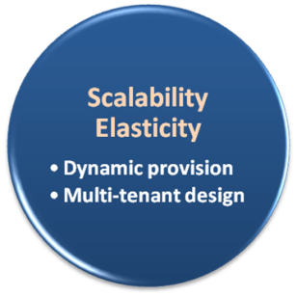

Scalability & Elasticity
Give me the world without limitation!!

Slide 91
Scalability & Elasticity
What is scalability ?
A desirable property of a system, a network, or a process, which indicates its ability to either handle growing amounts of work in a graceful manner or to be readily enlarged.
What is elasticity ?
The ability to apply a quantifiable methodology that allows for the basis of an adaptive introspection with in a real time infrastructure.
But how to achieve these properties ?
Dynamic provisioning
Multi-tenant design

Slide 92
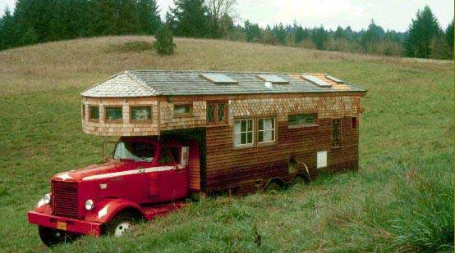
Dynamic Provisioning
What is dynamic provisioning ?
Dynamic Provisioning is a simplified way to explain a complex networked server computing environment where server computing instances are provisioned or deployed from a administrative console or client application by the server administrator, network administrator, or any other enabled user.

Slide 93
Over-provisioning – Out of Cloud
Allocated IT-capacities
“Under-supply“ IT Capacities
“Waste“ IT Capacities
IT CAPACITY
Load Forecast
Fixed Cost of
IT-capacities
Actual Load
TIME
Courtesy of Microsoft

Slide 94
Over-provisioning – Out of Cloud... Btw, who remembers where we have seen this already!?
Allocated IT-capacities
“Under-supply“ IT Capacities
“Waste“ IT Capacities
IT CAPACITY
Load Forecast
Fixed Cost of
IT-capacities
Actual Load
TIME
Courtesy of Microsoft

Slide 95
Cloud-provisioning
Allocated IT capacities
Load Forecast
No “under-supply“
IT CAPACITY
Reduction of “over-supply“
Possible reduction of IT-capacities in case of reduced load
Actual Load
Reduction of initial investments
TIME
Courtesy of Microsoft

Slide 96


Cloud-provisioning
Reduce Costs
Allocated IT capacities
Load Forecast
No “under-supply“
IT CAPACITY
Improve Performance
Reduction of “over-supply“
Possible reduction of IT-capacities in case of reduced load
Actual Load
Reduction of initial investments
TIME
Courtesy of Microsoft

Slide 97


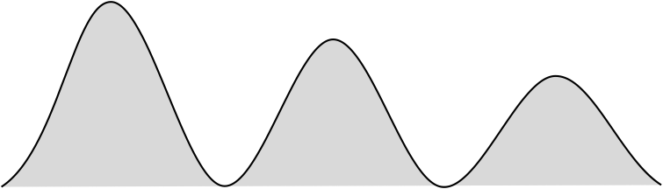

Dynamic Provisioning
In traditional computing model, two common problems :
Underestimate system utilization which result in under provision
Loss Revenue
Resources
Capacity
Resources
Demand
Capacity
1
2
3
Demand
Loss Users
Resources
Capacity
1
2
3
Time (days)
Demand
1
2
3

Slide 98
Dynamic Provisioning
Overestimate system utilization which result in low utilization
How to solve this problem ??
Dynamically provision resources
Capacity
Resources
Unused resources
Demand
Time

Slide 99
Dynamic Provisioning
Cloud resources should be provisioned dynamically
Meet seasonal demand variations
Meet demand variations between different industries
Meet burst demand for some extraordinary events
Resources
Capacity
Resources
Capacity
Demand
Demand
Time
Time

Slide 100
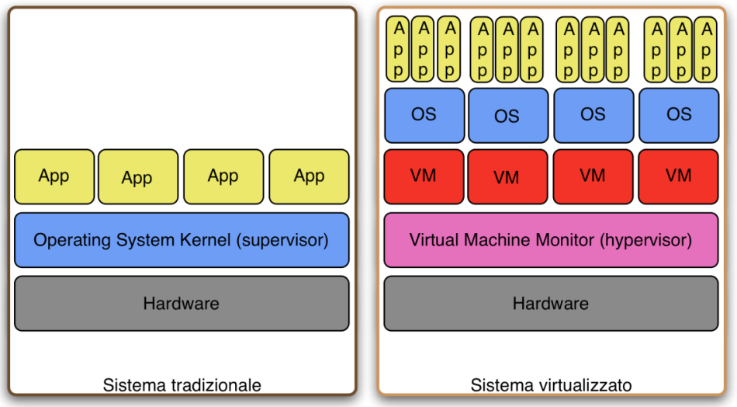
Basic Architecture & Deployment Principle: Virtualization
Hardware resources (CPU, RAM, ecc...) are partitioned and shared among multiple virtual machines (VMs)
The virtual machine monitor (VMM or hypervisor) governs the access to the physical resources among running VMs
Performance isolation and security
VMs run possibly different OSs
A single OS

Slide 101
Multi-tenant Design
What is multi-tenant design ?
Multi-tenant refers to a principle in software architecture where a single instance of the software runs on a server, serving multiple client organizations.
With a multi-tenant architecture, a software application is designed to virtually partition its data and configuration thus each client organization works with a customized virtual application instance.
Client oriented requirements :
Customization
Multi-tenant applications are typically required to provide a high degree of customization to support each target organization's needs.
Quality of service
Multi-tenant applications are expected to provide adequate levels of security and robustness.

Slide 102
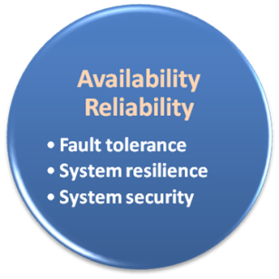

Availability & Reliability
Data Never Lost Machine Never Fail

Slide 103
Availability & Reliability
What is availability ?
The degree to which a system, subsystem, or equipment is in a specified operable and committable state at the start of a mission, when the mission is called for at an unknown time.
Cloud system usually require high availability
Ex. “Five Nines” system would statistically provide 99.999% availability
What is reliability ?
The ability of a system or component to perform its required functions under stated conditions for a specified period of time.
But how to achieve these properties ?
Fault tolerance system
Require system resilience
Reliable system security

Slide 104
Fault Tolerance
What is fault tolerant system ?
Fault-tolerance is the property that enables a system to continue operating properly in the event of the failure of some of its components.
If its operating quality decreases at all, the decrease is proportional to the severity of the failure, as compared to a naively-designed system in which even a small failure can cause total breakdown.
Four basic characteristics :
No single point of failure
Fault detection and isolation to the failing component
Fault containment to prevent propagation of the failure
Availability of reversion modes

Slide 105

Fault Tolerance
Single Point Of Failure (SPOF)
A part of a system which, if it fails, will stop the entire system from working.
The assessment of a potentially single location of failure identifies the critical components of a complex system that would provoke a total systems failure in case of malfunction.
Preventing single point of failure
If a system experiences a failure, it must continue to operate without interruption during the repair process.

Slide 106

Fault Tolerance
Fault Detection and Isolation (FDI)
A subfield of control engineering which concerns itself with monitoring a system, identifying when a fault has occurred and pinpoint the type of fault and its location.
Isolate failing component
When a failure occurs, the system must be able to isolate the failure to the offending component.

Slide 107
Fault Tolerance
Fault Containment
Some failure mechanisms can cause a system to fail by propagating the failure to the rest of the system.
Mechanisms that isolate a rogue transmitter or failing component to protect the system are required.
Available of reversion modes
System should be able to maintain some check points which can be used in managing the state changes.

Slide 108
System Resilience
What is resilience ?
Resilience is the ability to provide and maintain an acceptable level of service in the face of faults and challenges to normal operation.
Resiliency pertains to the system's ability to return to its original state after encountering trouble. In other words, if a risk event knocks a system offline, a highly resilient system will return back to work and function as planned as soon as possible.
Some risk events
If power is lost at a plant for two days, can our system recover ?
If a key service is lost because a database corruption, can the business recover ?

Slide 109

System Resilience
Disaster Recovery
Disaster recovery is the process, policies and procedures related to preparing for recovery or continuation of technology infrastructure critical to an organization after a natural or human-induced disaster.
Some common strategies :
Backup
Make data off-site at regular interval
Replicate data to an off-site location
Replicate whole system
Preparing
Local mirror systems
Surge protector
Uninterruptible Power Supply (UPS)

Slide 110
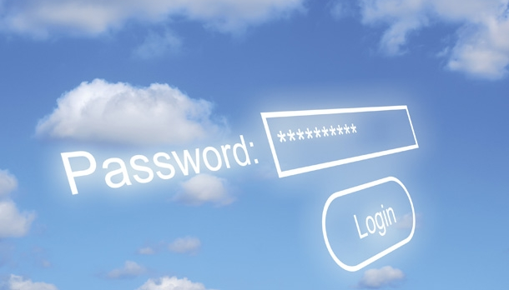
System Security
Security issue in Cloud Computing :
Cloud security is an evolving sub-domain of computer security, network security, and, more broadly, information security.
It refers to a broad set of policies, technologies, and controls deployed to protect data, applications, and the associated infrastructure of cloud computing.

Slide 111
System Security
Important security and privacy issues :
Data Protection
To be considered protected, data from one customer must be properly segregated from that of another.
Identity Management
Every enterprise will have its own identity management system to control access to information and computing resources.
Application Security
Cloud providers should ensure that applications available as a service via the cloud are secure.
Privacy
Providers ensure that all critical data are masked and that only authorized users have access to data in its entirety.

Slide 112
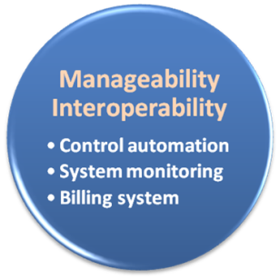

Manageability & Interoperability
I Want Full Control !!

Slide 113
Manageability & Interoperability
What is manageability ?
Enterprise-wide administration of cloud computing systems. Systems manageability is strongly influenced by network management initiatives in telecommunications.
What is interoperability ?
Interoperability is a property of a product or system, whose interfaces are completely understood, to work with other products or systems, present or future, without any restricted access or implementation.
But how to achieve these properties ?
System control automation
System state monitoring

Slide 114

System Monitoring
What is a system monitor ?
A System Monitor in systems engineering is a process within a distributed system for collecting and storing state data.
What should be monitored in the Cloud ?
Physical and virtual hardware state
Resource performance metrics
Network access patterns
System logs
… etc
Anything more ?
Billing system

Slide 115

Billing System
Billing systems in Cloud Computing
Users pay as many as they used.
Cloud provider must first determine the list of service usage price.
Cloud provider have to record the resource or service usage of each user, and then charge users by these records.
How can cloud provider know users’ usage ?
Get those information by means of monitoring system.
Automatically calculate the total amount of money which user should pay. And automatically request money from use’s banking account.

Slide 116
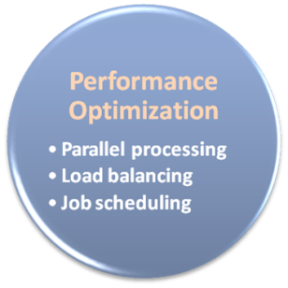

Load Balancing
What is load balancing ?
Load balancing is a technique to distribute workload evenly across two or more computers, network links, CPUs, hard drives, or other resources, in order to get optimal resource utilization, maximize throughput, minimize response time, and avoid overload.
Why should be load balanced ?
Improve resource utilization
Improve system performance
Improve energy efficiency

Slide 117
Job Scheduling
What is job scheduler ?
A job scheduler is a software application that is in charge of unattended background executions, commonly known for historical reasons as batch processing.
What should be scheduled in Cloud ?
Computation intensive tasks
Dynamic growing and shrinking tasks
Tasks with complex processing dependency
How to approach ?
Use pre-defined workflow
System automatic configuration

Slide 118
Fancy Title for Cloud Job Scheduling and Management
Cloud Orchestrators!
Apache Brooklyn
Gigaspaces Cloudify
Apache Juju
…

Slide 119
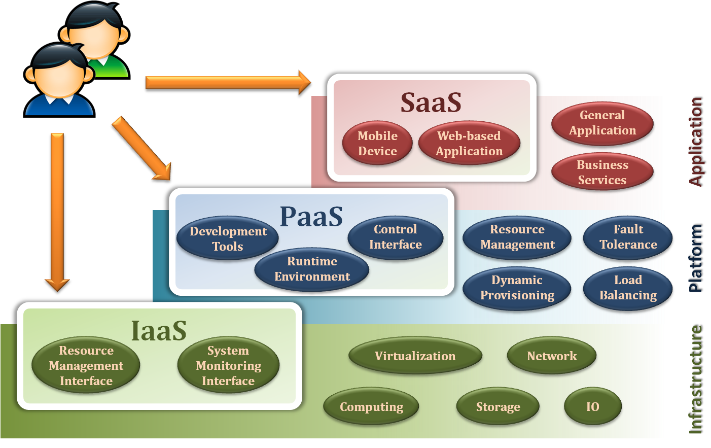
Service Model Overview

Slide 120
Service Models
Infrastructure as a Service
Platform as a Service
Software as a Service

Slide 121
Infrastructure as a Service
Infrastructure as a Service - IaaS
The capability provided to the consumer is to provision processing, storage, networks, and other fundamental computing resources where the consumer is able to deploy and run arbitrary software, which can include operating systems and applications.
The consumer does not manage or control the underlying cloud infrastructure but has control over operating systems, storage, deployed applications, and possibly limited control of select networking components .
Examples :
Amazon EC2
Eucalyputs
OpenNebula
… etc

Slide 122
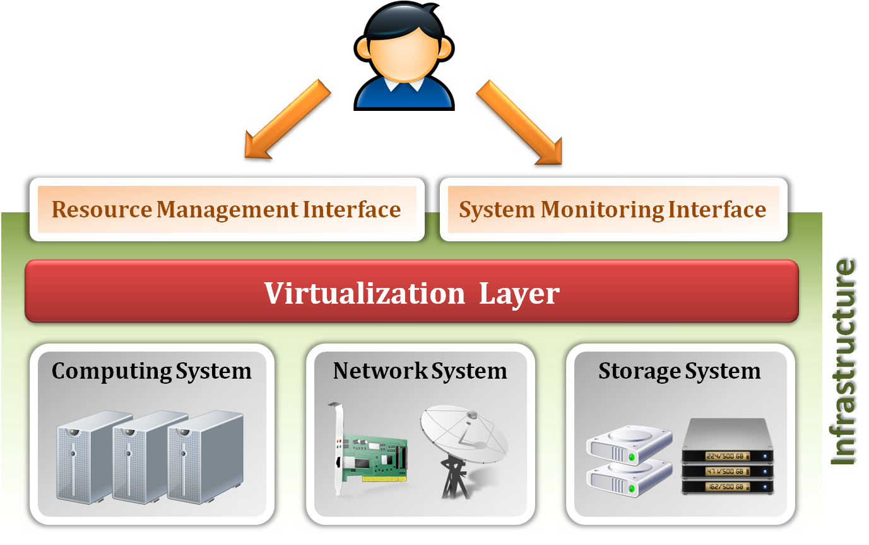
Infrastructure as a Service
System architecture :

Slide 123
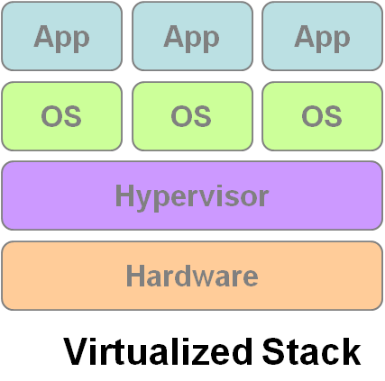
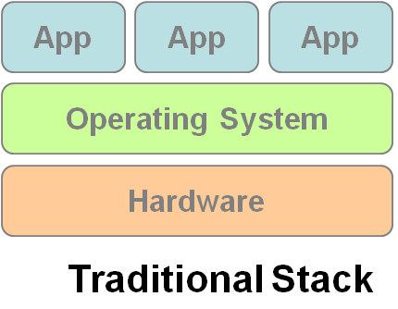
Infrastructure as a Service
Enabling technique - Virtualization
Virtualization is an abstraction of logical resources away from underlying physical resources.
Virtualization technique shift OS onto hypervisor.
Multiple OS share the physical hardware and provide different services.
Improve utilization, availability, security and convenience.
VM1
VM2
VM3

Slide 124
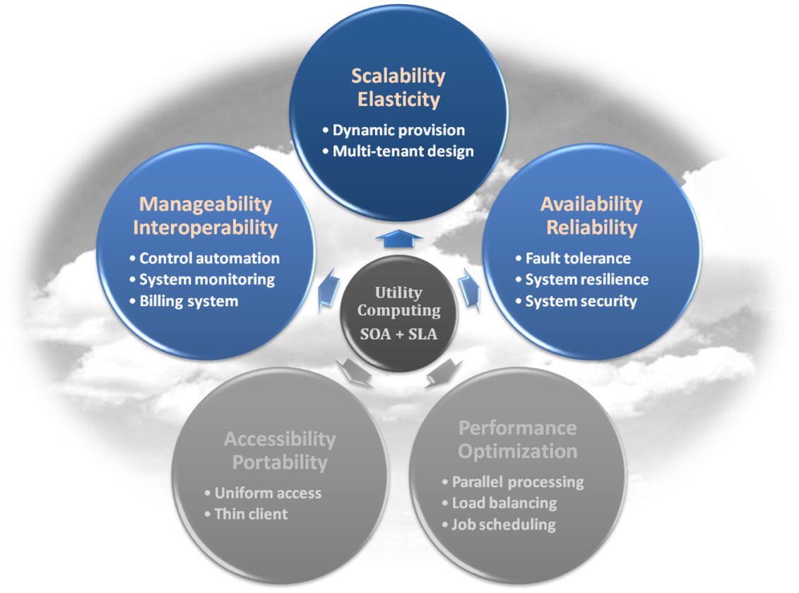
Infrastructure as a Service
Properties supported by virtualization technique :
Manageability and Interoperability
Availability and Reliability
Scalability and Elasticity

Slide 125
Infrastructure as a Service
Provide service –Resource Management Interface
Several types of virtualized resource :
Virtual Machine – As an IaaS provider, we should be able to provide the basic virtual machine operations, such as creation, suspension, resumption and termination, …etc.
Virtual Storage – As an IaaS provider, we should be able to provide the basic virtual storage operations, such as space allocation, space release, data writing and data reading, …etc.
Virtual Network – As an IaaS provider, we should be able to provide the basic virtual network operations, such as IP address allocation, domain name register, connection establishment and bandwidth provision, …etc.

Slide 126
Infrastructure as a Service
Provide service – System Monitoring Interface
Several types of monitoring metrics :
Virtual Machine – As an IaaS provider, we should be able to monitor some system states of each virtual machine, such as CPU loading, memory utilization, IO loading and internal network loading, …etc.
Virtual Storage – As an IaaS provider, we should be able to monitor some storage states of each virtual storage, such as virtual space utilization, data duplication and storage device access bandwidth, …etc.
Virtual Network – As an IaaS provider, we should be able to monitor some network states of each virtual network, such as virtual network bandwidth, network connectivity and network load balancing, …etc.

Slide 127
IaaS - Summary
IaaS is the deployment platform that abstract the infrastructure.
IaaS enabling technique
Virtualization
Server Virtualization
Storage Virtualization
Network Virtualization
IaaS provided services
Resource Management Interface
System Monitoring Interface

Slide 128
Service Models
Infrastructure as a Service
Platform as a Service
Software as a Service

Slide 129
Platform as a Service
Platform as a Service - PaaS
The capability provided to the consumer is to deploy onto the cloud infrastructure consumer-created or acquired applications created using programming languages and tools supported by the provider.
The consumer does not manage or control the underlying cloud infrastructure including network, servers, operating systems, or storage, but has control over the deployed applications and possibly application hosting environment configurations.
Examples :
Microsoft Windows Azure
Google App Engine
Hadoop
… etc

Slide 130
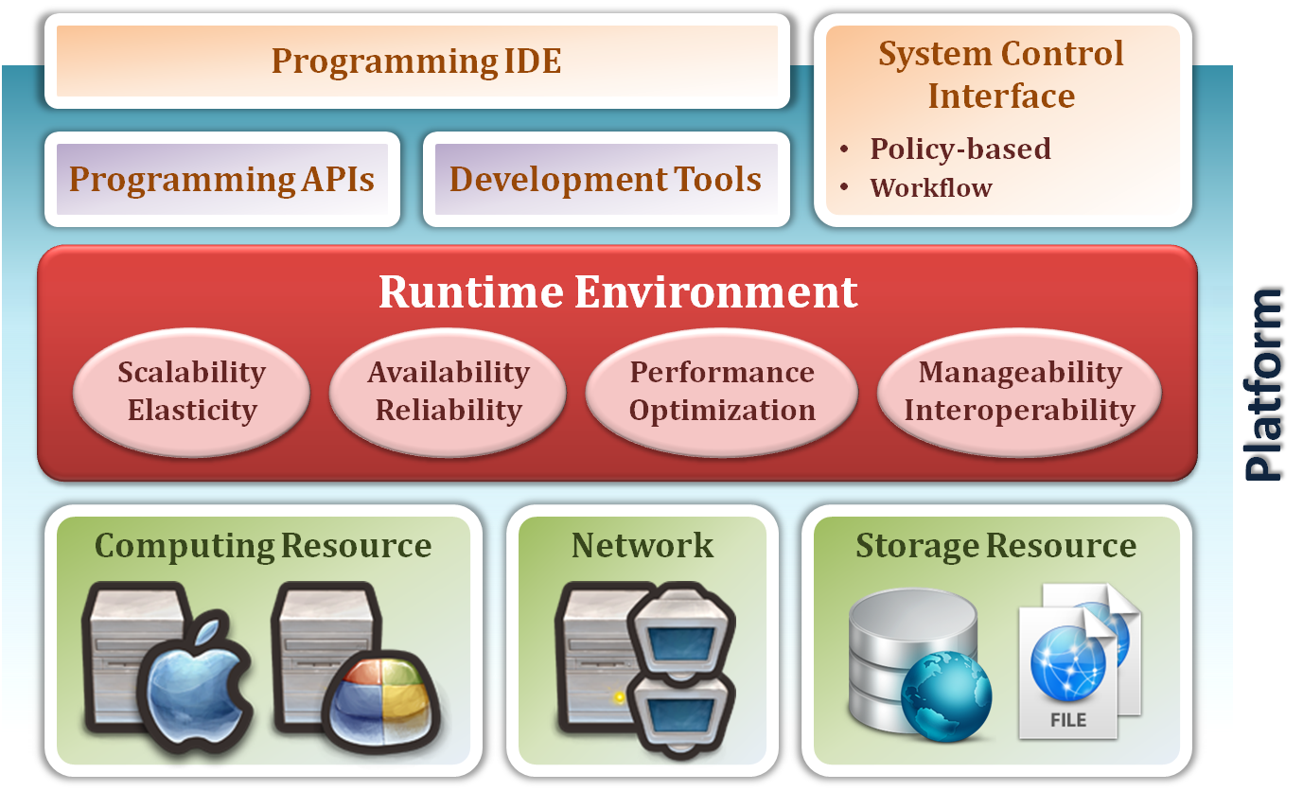
Platform as a Service
System architecture :

Slide 131
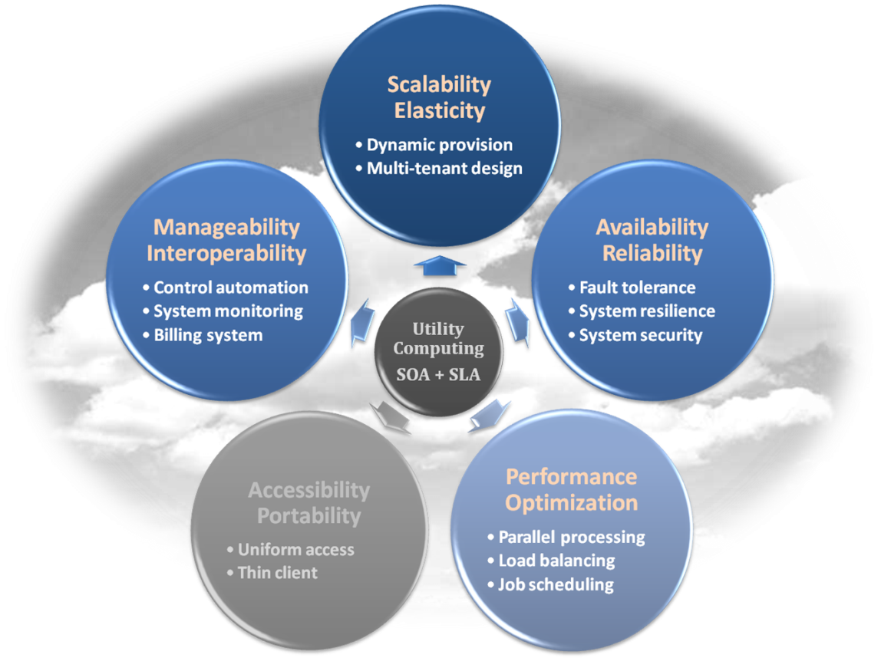
Platform as a Service
Enabling technique – Runtime Environment Design
Runtime environment refers to collection of software services available. Usually implemented by a collection of program libraries.
Common properties in Runtime Environment :
Manageability and Interoperability
Performance and Optimization
Availability and Reliability
Scalability and Elasticity

Slide 132
Platform as a Service
Provide service – Programming IDE
Users make use of programming IDE to develop their service among PaaS.
This IDE should integrate the full functionalities which supported from the underling runtime environment.
This IDE should also provide some development tools, such as profiler, debugger and testing environment.
The programming APIs supported from runtime environment may be various between different cloud providers, but there are still some common operating functions.
Computation, storage and communication resource operation

Slide 133
Platform as a Service
Provide service – System Control Interface
Police-Based Control
Typically described as a principle or rule to guide decisions and achieve rational outcome(s)
Make the decision according to some requirements
Workflow Control
Describe the flow of installation and configuration of resources
Workflow processing daemon delivers speedy and efficient construction and management of cloud resources

Slide 134
PaaS - Summary
PaaS is the development platform that abstract the infrastructure, OS, and middleware to drive developer productivity.
PaaS enabling technique
Runtime Environment
PaaS provide services
Programming IDE
Programming APIs
Development tools
System Control Interface
Policy based approach
Workflow based approach

Slide 135
Service Models
Infrastructure as a Service
Platform as a Service
Software as a Service

Slide 136
Software as a Service
Software as a Service - SaaS
The capability provided to the consumer is to use the provider’s applications running on a cloud infrastructure. The applications are accessible from various client devices through a thin client interface such as a web browser (e.g., web-based email).
The consumer does not manage or control the underlying cloud infrastructure including network, servers, operating systems, storage, or even individual application capabilities, with the possible exception of limited user-specific application configuration settings.
Examples :
Google Apps (e.g., Gmail, Google Docs, Google sites, …etc)
DropBox
… etc

Slide 137
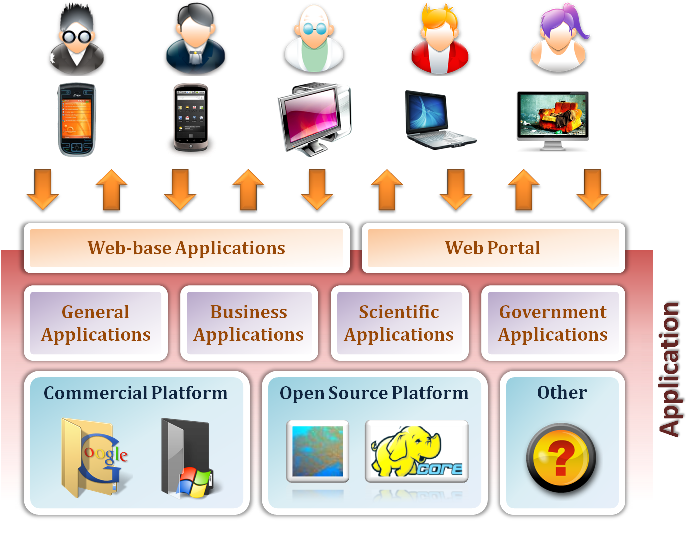
Software as a Service

Slide 138
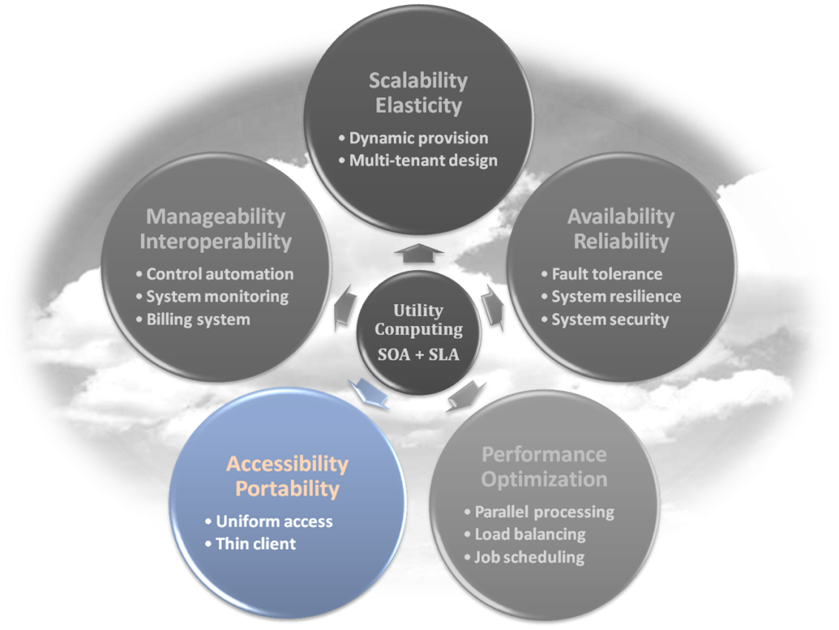
Software as a Service
Enabling Technique – Web Service
Web 2.0 is the trend of using the full potential of the web
Viewing the Internet as a computing platform
Running interactive applications through a web browser
Leveraging interconnectivity and mobility of devices
Enhanced effectiveness with greater human participation
Properties provided by Internet :
Accessibility and Portability

Slide 139
Software as a Service
Provide service – Web-based Applications
Conventional applications should translate their access interface onto web-based platform.
Applications in different domains
General Applications – Applications which are designed for general propose, such as office suit, multimedia and instant message, …etc.
Business Applications – Application which are designed for business propose, such as ERP, CRM and market trading system, …etc.
Scientific Applications – Application which are designed for scientific propose, such as aerospace simulation and biochemistry simulation, …etc.
Government Applications – Applications which are designed for government propose, such as national medical system and public transportation system service, …etc.

Slide 140
Software as a Service
Provide service – Web Portal
Apart from the standard search engine feature, web portals offer other services such as e-mail, news, stock prices, information, databases and entertainment.
Portals provide a way for enterprises to provide a consistent look and feel with access control and procedures for multiple applications and databases, which otherwise would have been different entities altogether.
Some examples :
iGoogle
MSNBC
Netvibes
Yahoo!

Slide 141
SaaS - Summary
SaaS is the finished applications that you rent and customize.
SaaS enabling technique
Web Service
SaaS provide services
Web-based Applications
General applications
Business applications
Scientific applications
Government applications
Web Portal

Slide 142

Deployment models
How to deploy a cloud system ?

Slide 143
Deployment Model
There are four primary cloud deployment models :
Public Cloud
Private Cloud
Community Cloud
Hybrid Cloud
Each can exhibit the previously discussed characteristics; their differences lie primarily in the scope and access of published cloud services, as they are made available to service consumers.

Slide 144
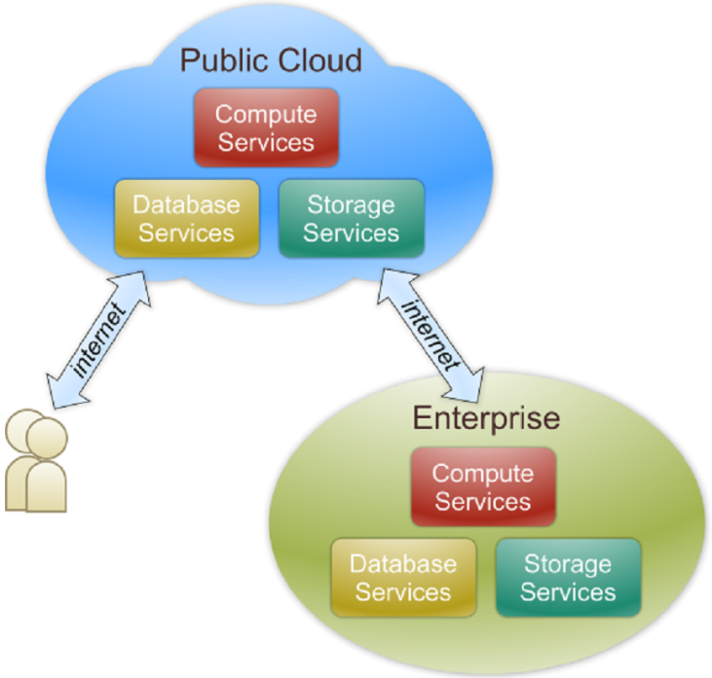
Public Cloud
Public cloud definition
The cloud infrastructure is made available to the general public or a large industry group and is owned by an organization selling cloud services.
Also known as external cloud or multi-tenant cloud, this model essentially represents a cloud environment that is openly accessible.
Basic characteristics :
Homogeneous infrastructure
Common policies
Shared resources and multi-tenant
Leased or rented infrastructure
Economies of scale

Slide 145
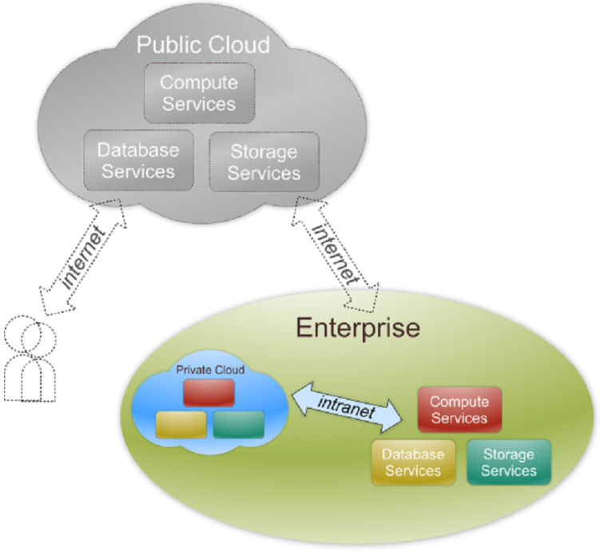
Private Cloud
Private cloud definition
The cloud infrastructure is operated solely for an organization. It may be managed by the organization or a third party and may exist on premise or off premise.
Also referred to as internal cloud or on-premise cloud, a private cloud intentionally limits access to its resources to service consumers that belong to the same organization that owns the cloud.
Basic characteristics :
Heterogeneous infrastructure
Customized and tailored policies
Dedicated resources
In-house infrastructure
End-to-end control

Slide 146
Public vs. Private
Comparison :
 | Public Cloud | Private Cloud
Infrastructure | Homogeneous | Heterogeneous
Policy Model | Common defined | Customized & Tailored
Resource Model | Shared & Multi-tenant | Dedicated
Cost Model | Operational expenditure | Capital expenditure
Economy Model | Large economy of scale | End-to-end control

Slide 147
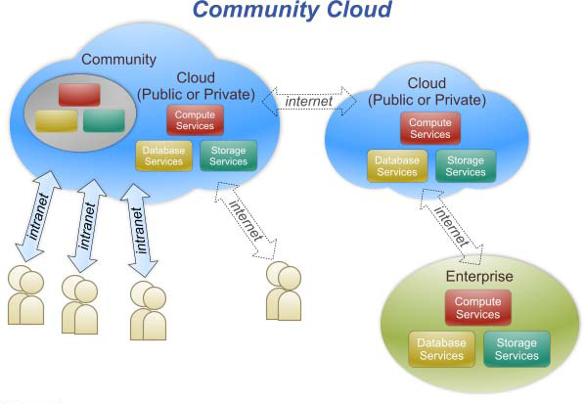
Community Cloud
Community cloud definition
The cloud infrastructure is shared by several organizations and supports a specific community that has shared concerns (e.g., mission, security requirements, policy, and compliance considerations).

Slide 148

Hybrid Cloud
Hybrid cloud definition
The cloud infrastructure is a composition of two or more clouds (private, community, or public) that remain unique entities but are bound together by standardized or proprietary technology that enables data and application portability (e.g., cloud bursting for load-balancing between clouds).

Slide 149

Cloud Ecosystem

Slide 150
Summary
What is cloud computing in your mind
Clear or Cloudy?
Cloud computing is a new paradigm shift of computing
Cloud computing can provide high quality of properties and characteristics based on essentially central ideas
Service models and deployment models provide services that can be used to
Rent fundamental computing resources
Deploy and develop customer-created applications on clouds
Access provider’s applications over network (wired or wireless)

Slide 151

Summary
Cloud: A coherent, large-scale, publicly accessible collection of compute,
storage, and networking resources
Available via Web service calls
through the Internet
Short- or long-term access on a pay per use basis

Slide 152

Cloud: Cloud General Characteristics
Scaling up and scaling down of resource usage on an as-needed basis
Economies of scale: The cloud provider can procure real estate, power, cooling, bandwidth, and hardware at the best possible prices
Pay-as-you-go: Resource allocation decisions have an immediate effect on resource consumption and the level of overall costs

Slide 153
Common (wrong) assumptions in distributed computing
The network is reliable
Latency is zero
Bandwidth is infinite
The network is secure
Topology doesn’t change
There is one administrator
Transport cost is zero
The network is homogeneous
-- Deutsch & Gosling
Notes:
153

Slide 154
References
NIST (National Institute of Standards and Technology). http://csrc.nist.gov/groups/SNS/cloud-computing/
M. Armbrust et. al., “Above the Clouds: A Berkeley View of Cloud Computing,” Technical Report No. UCB/EECS-2009-28, University of California at Berkeley, 2009.
R. Buyya et. al., “Cloud computing and emerging IT platforms: Vision, hype, and reality for delivering computing as the 5th utility,” Future Generation Computer Systems, 2009.
Cloud Computing Use Cases. http://groups.google.com/group/cloud-computing-use-cases
Cloud Computing Explained. http://www.andyharjanto.com/2009/11/wanted-cloud-computing-explained-in.html
From Wikipedia, the free encyclopedia
All resources of the materials and pictures were partially retrieved from the Internet.

Slide 155
Cloud Service Models
IaaS
You manage
PaaS
SaaS
Applications
Applications
Applications
You manage
You don’t manage any
Runtimes
Runtimes
Runtimes
Security & Integration
Security & Integration
Security & Integration
Managed by vendor
Databases
Databases
Databases
Servers
Servers
Servers
Managed by vendor
Virtualization
Virtualization
Virtualization
Server HW
Server HW
Server HW
Storage
Storage
Storage
Networking
Networking
Networking
Courtesy of Microsoft

Slide 156
Cloud Design: Classification of patterns
Basic Architectural Patterns
Composite Application
Loose Coupling
Stateless Component
Idempotent Component
Elasticity Patterns
Map Reduce
Elastic Component
Elastic Load Balancer
Elastic Queue
Availability Patterns
Watchdog
Update Transition
Multi-Tenancy Patterns
Single Instance Component
Single Configurable Instance Component
Multiple Instance Component

Slide 157
Stateless components
Context
A componentized application subsumes components that can fail.
Challenges
Cloud resources can display low availability.
Component instances can be added and removed regularly when the demand changes.
Solution
Implement the components in a way that they do not contain any internal state, but completely rely on external persistent storage.

Slide 158

Stateless components
No data is lost if an instance fails
Multiple components have a common internal state
The scalability of the central data store becomes the major challenge
Distributed data stores

Slide 159
Elastic component
Context
A componentized application uses multiple compute nodes provided by an elastic infrastructure.
Challenges
To benefit from the elastic infrastructure, the management process to scale-out a componentized application has to be automated.
Manual resource scaling would not support pay-per-use nor quickly changing workload
Solution
Monitor the utilization of compute nodes that host application components and automatically adjust their numbers using the provisioning functionality provided by the elastic infrastructure.

Slide 160

Elastic component
If the utilization of compute nodes exceeds a specified threshold, additional hosting components are provisioned that contain the same application component.
If the components are implemented as stateless components, the operations for adding and removal of components are significantly simplified.

Slide 161
Elastic load balancer
Context
A componentized application uses multiple compute nodes provided by an elastic infrastructure.
Challenges
As for elastic component
Service requests are a good indicator of workload and therefore shall be used as a basis for scaling decisions
Solution
Use an elastic load balancer that determines the amount of required resources based on numbers of requests and provisions the needed resources accordingly using the elastic infrastructure’s API

Slide 162

Elastic load balancer
The number of requests that can be handled by a computing node is a crucial design parameter
It has to be adjusted at run time
Information about the time needed to provision new compute nodes can also be necessary to deduct effective scaling actions

Slide 163
Principles of Cloud Orchestration, Containerisation and More!

Slide 164
Microservices

Slide 165
Microservices
Architecture Principles:
Statelessness
Available in multiple copies
No data sharing among peers
Each microservice its own DB
Data-Intensive Message Brokering
Message queues

Slide 166
Microservices
Why Micro-?
Stateless Available in multiple
No data sharing among microservices
Each microservice uses a specific database
Container!

Slide 167
Terminology - Image
Persisted snapshot that can be run
images: List all local images
run: Create a container from an image and execute a command in it
tag: Tag an image
pull: Download image from repository
rmi: Delete a local image
This will also remove intermediate images if no longer used

Slide 168
Terminology - Container
Runnable instance of an image
ps: List all running containers
ps –a: List all containers (incl. stopped)
top: Display processes of a container
start: Start a stopped container
stop: Stop a running container
pause: Pause all processes within a container
rm: Delete a container
commit: Create an image from a container
Notes:
docker run --rm to remove container after termination

Slide 169
Image vs. Container
Base Image
ubuntu:latest
run
Container
cid1
base image
cmd → new state
New Image
iid1
commit
Container
cid1
run
Container
cid2
Container
cid3
Container
cid4

Slide 170
Example: Docker
Docker is an open-source project that automates the deployment of applications inside software containers, by providing an additional layer of abstraction and automation of operating system–level virtualization on Linux.
[Source: en.wikipedia.org]

Slide 171

Docker: Name
[www.docker.com]
docker [naut.]: der Dockarbeiter, der Hafenarbeiter
Source: leo.org
Provide a uniformed wrapper around a software package: «Build, Ship and Run Any App, Anywhere» [www.docker.com]
Similar to shipping containers: The container is always the same, regardless of the contents and thus fits on all trucks, cranes, ships, ...

Slide 172


Docker vs. Virtual Machine
Source: https://www.docker.com/whatisdocker/
Notes:
Virtual Machines
Each virtualized application includes not only the application - which may be only 10s of MB - and the necessary binaries and libraries, but also an entire guest operating system - which may weigh 10s of GB.
Docker
The Docker Engine container comprises just the application and its dependencies. It runs as an isolated process in userspace on the host operating system, sharing the kernel with other containers. Thus, it enjoys the resource isolation and allocation benefits of VMs but is much more portable and efficient.
Docker provides base images that contain OS installations we can start from: The OS is not more than an application running on the Kernel...

Slide 173

Docker Technology
libvirt: Platform Virtualization
LXC (LinuX Containers): Multiple isolated Linux systems (containers) on a single host
Layered File System
[Source: https://docs.docker.com/terms/layer/]

Slide 174
Docker History
2013-03: Releases as Open Source
2013-09: Red Hat collaboration (Fedora, RHEL, OpenShift)
2014-03: 34th most starred GitHub project
2014-05: JAX Innovation Award (most innovative open technology)

Slide 175
Run Platforms
Various Linux distributions (Ubuntu, Fedora, RHEL, Centos, openSUSE, ...)
Cloud (Amazon EC2, Google Compute Engine, Rackspace)
2014-10: Microsoft announces plans to integrate Docker with next release of Windows Server
Notes:
Windows: http://www.zdnet.com/docker-cto-why-microsofts-docker-plans-for-windows-will-matter-to-you-7000035150/
"That's why the result of the Microsoft announcement will not allow a container that runs on Linux to run seamlessly on Windows or vice versa. But that's OK because in the context of distributed applications that's not what developers are asking for."

Slide 176
Hello World
Simple Command - Ad-Hoc Container
docker run ubuntu echo Hello World
docker images [-a]
docker ps –a
Notes:
Immediately exits
docker ps
docker ps –a
Re-attach: docker start –i stoic_wozniak
docker commit –m «message» containerId imageName(e.g. mytest/test1:1.0)
New Image
docker images

Slide 177
Container ➔ Dockerfile
Create images automatically using a build script: «Dockerfile»
Can be versioned in a version control system like Git or SVN, along with all dependencies
Docker Hub can automatically build images based on dockerfiles on Github

Slide 178
Dockerfile Example
Dockerfile:
FROM ubuntu ENV DOCK_MESSAGE Hello My World ADD dir /files CMD ["bash", "someScript"]
docker build [DockerFileDir]
docker inspect [imageId]
Notes:
docker run -ti d97 /bin/bash
testFile.txt -> present
set -> env Variable PROVIDER set
docker run –P -d d97

Slide 179
Docker Hub
Public repository of Docker images
https://hub.docker.com/
docker search [term]
Automated: Has been automatically built from Dockerfile
Source for build is available on GitHub
Notes:
Automatically build a Docker image on Docker-Hub:
Example: playground-docker-echoey in Bitbucket: https://bitbucket.org/inftec/playground-docker-echoey/overview
Automated Build Repository on Docker Hub: https://registry.hub.docker.com/u/pazoozoo/playground-docker-echoey/
Build took around 5 minutes...
Run on AWS Elastic Beanstalk:
Need to ZIP Dockerfile and dependencies (ADD files)
Beanstalk environment expects HTTP service on first EXPOSEd port though → not working with dummy echo service

Slide 180
Docker Use Cases
Development Environment
Environments for Integration Tests
Quick evaluation of software
Microservices
Multi-Tenancy
Unified execution environment (dev → test → prod (local, VM, cloud, ...)

Slide 181
But what is Docker for, actually?
Infrastructure-as-code!
“A DevOps Tactic for accelerated, versionable, high-quality, highly-deployable cloud applications”

Slide 182
DevOps ➔ later in this course...
Infrastructure-as-Code!
“A DevOps Tactic for accelerated, versionable, high-quality, highly-deployable cloud applications”

Slide 183
Our Focus for The rest of the day
Dev
Ops
Dev
Ops
Dev
DevOps
Ops
Smooth collaboration
Fully Embedded
Infrastructure as a Service
Infrastructure Automation
Application Management
Version Control
Continuous Integration
“Infrastructure-as-Code:
Using typical code development practices (VCS, debugging, design patterns, etc.) for fast, maintainable, and reliable
Infrastructure automation”
[Cit. Myself]
Dev
DevOps
Ops
Dev
DevOps
Ops
DevOps as a Service
Temporary DevOps Team

Slide 184
What’s in the box?
Infrastructure Automation Phases/Tools
1.Configuration Management
2. Server Provisioning
3. Application Deployment
4. Monitoring
5. Self-Adaptation
Infrastructure Automation
Application Management
Version Control
Continuous Integration

Slide 185
1. Configuration Management
Objective: provide automated configuration and lifecycle management of a single service;
Population: 70+ tools;
Main Examples:
Docker Hub, (market leader, very active);
Chef, (with own environment, IasC in pure-Ruby);
Puppet (ruby-based, multi-platform, own declarative language);
Ansible (Agentless, also does provisioning & deploy);
Otter (specific for Win+.Net);
…
Notes:
Comparison here: https://en.wikipedia.org/wiki/Comparison_of_open-source_configuration_management_software

Slide 186
2. Server Provisioning
Objective: provide automated physical resources retrieval and virtualization management;
Population: 50+ tools;
Main Examples:
Cloudify, (TOSCA-based, live community, full orchestration engine);
Terraform, (full-stack support from bare-metal to SaaS);
Ansible, (we said this before);
Foreman, (complete life cycle systems management tool for provisioning);
…
Notes:
https://xebialabs.com/the-ultimate-devops-tool-chest/provisioning-config-management/
https://xebialabs.com/periodic-table-of-devops-tools/
Less famous example: https://en.wikipedia.org/wiki/Cobbler_(software)

Slide 187
3. Application Deployment
Objective: provide automated continuous component-based application deployment;
Population: 50+ tools;
Main Examples:
Cloudify, (TOSCA-based, live community, full orchestration engine);
Apache Brooklyn, (open-source component definition, massive cloud support);
Ansible, (we said this before);
…

Slide 188

Summarising...

Slide 189

Summarising... cont’d

Slide 190

What is Infrastructure Automation?
Def. Infrastructure Automation ➔ a deployment script for any cloud application:
Infrastructure Automation
Application Management
Version Control
Continuous Integration
Host
App module
Middleware
connection
Note: this is a “simple” web application, think website!

Slide 191
What is Infrastructure Automation?
What do we see here? I.e. what’s behind the curtain?
Infrastructure Automation
Application Management
Version Control
Continuous Integration
Host
App module
Middleware
connection
Moment of suspense…

Slide 192
Towards Infrastructure-as-Code
Def. Infrastructure Automation ➔ an Install, Deploy... script for any or all of these below:
Infrastructure Automation
Application Management
Version Control
Continuous Integration
Infrastructure
Host
Host
Network
Middleware
Apache
Tomcat
MySQL
Application
Mod_proxy
WAR
Schema
An Application Deployment Topology, i.e., “a graph of physical artefacts that need support for several lifecycle phases (e.g., procurement, installation, configuration, deployment, teardown, etc.)” [6]

Slide 193
Towards Infrastructure-as-Code
An Application Deployment Topology, i.e., “a graph of physical artefacts that need support for several lifecycle phases (e.g., procurement, installation, configuration, deployment, undeployment, teardown, etc.)” [6]
Infrastructure
Host
Host
Network
Middleware
Apache
Tomcat
MySQL
Application
Mod_proxy
WAR
Schema

Slide 194
Towards Infrastructure-as-Code
Infrastructure-as-code, i.e., “a blueprint detailing physical artefacts, all scripts for all lifecycle phases and all artefacts needed for deployment” [6]
IasC Blueprint
Infrastructure
Host
Host
Network
Referenced in
Middleware
Apache
Tomcat
MySQL
IasC Middleware Scripts (e.g., Chef, Puppet, etc.)
Included in
Deploy artefacts (e.g., JARs, etc.)
Application
Mod_proxy
WAR
Schema

Slide 195
Where Does TOSCA fit into?
TOSCA: Here’s What We’ve Seen there…
An application topology
3 layers
Infrastructure (Cloud or DC objects)
Platform or Middleware (App containers)
Application modules, schemas and configurations
Relationships between components:
What’s hosted on what or installed on what
What’s connected to what
Infrastructure
Host
Host
Network
Middleware
Apache
Tomcat
MySQL
Application
Mod_proxy
WAR
Schema

Slide 196

What’s in a TOSCA Topology?
component in the topology are called Nodes
Each Node has a Type (e.g. Host, BD, Web server).
The Type is abstract and hence portable
The Type defines Properties and Interfaces
An Interface is a set of hooks (named Operations)
Nodes are connected to one another using Relationships

Slide 197
TOSCA, IasC Standard
TOSCA Service Template [7]

Slide 198
TOSCA Core Ingredients
TOSCA Service Template

Slide 199

Node Type
Describes a Cloud or Software type (e.g. Server or Apache Foundation Software)
Maps the type to the actual impl. of the lifecycle interface

Slide 200

Node Type (cont.)
Defines properties as YAML maps
Might define capabilities (What it can provide to other nodes)

Slide 201
Digression… What is YAML?
Defines properties as YAML maps
It’s a human readable markup language (Yet Another Markup Language) dialect of JSON, as some would say, It’s “JSON with its pants down”

Slide 202

Node Type (cont.)
Might define requirements (what it needs from other nodes)

Slide 203
TOSCA Core Ingredients
TOSCA Service Template

Slide 204

Relationship Type
Requirements and Capabilities are an implicit way to describe relationships
Usually you need the explicit way
You need hooks to configure the source or target node or both
So relationships have types and interfaces as well

Slide 205
Relationships (cont.)
The basic relationship types are:
dependsOn – abstract type and its sub types:
hostedOn – a node is contained within another
connectsTo – a node has a connection configured to another
The basic interface is configure
preconfigure_source, preconfigure_target
postconfigure_source, postconfigure_target
add_target, remove_target

Slide 206
Node Templates
An instance of a type (like Object to Class)
Has specific properties
Has artifacts:
What to install
How to install (mapped to interface hooks)
Has requirements and capabilities (or relationships)

Slide 207


Node Template (Examples)

Slide 208
Translated to TOSCA
Node
Node
“Hosted_on”
relationship
Node
“Connects_to” relationship
Notes:
http://getcloudify.org/guide/3.0/guide-blueprint.html

Slide 209
Putting it All Together
TOSCA Blueprint contains:
Application Topology
Nodes
Interfaces
Properties
Artifacts (Plugins in Cloudify)
Relationships
Interfaces
Workflows
Policies

Slide 210
TOSCA YAML IasC Example
ELK Monitoring Stack
Elastic-search
Logstash
Kibana

Slide 211


Slide 214

ELK TOSCA IasC (Logstash)

Slide 215
Shall we go Home?
Coming up next… advanced SA Styles!

Slide 216
Before we go... Don’t Forget!
On Nov. 9th we will have our 1st project revision!
Prepare a presentation:
20 mins + questions
You will HAVE TO expose, at least:
(a) the architecture and organisational structure of the community and product;
(b) the properties and visible features of the architecture;
(c) the limitations and shortcomings of that product, how to install/interact with it;
You MAY want to use the concepts and notations we used up to this point;

Slide 217
References
Classical SA Patterns:
Bass, Len, Clements, Paul and Kazman, Rick. Software Architecture in Practice. : Addison Wesley, 1998.
Taylor, Richard N., Medvidovic, Nenad and Dashofy, Eric M.. Software Architecture: Foundations, Theory and Practice. : Addison-Wesley, 2007.
Cloud Architectural patterns:
http://www.sei.cmu.edu/library/assets/presentations/retter-saturn2013.pdf
Microsoft Development Network, SA Field Guide: https://msdn.microsoft.com/en-us/library/ff650706.aspx
Docker homepage: https://www.docker.com/
Introduction: https://www.docker.com/whatisdocker/
Online tutorial: https://www.docker.com/tryit/
Installation and user guide: https://docs.docker.com/
InfTec TecBoard: https://inftec.atlassian.net/wiki/display/TEC/Docker
Includes this presentation

Slide 218
Docker Hands On
https://bitbucket.org/inftec/vagrant-playground/branch/docker-demo
Multi-Container-Setup
Logging-Container
Echo-Container
Client-Container

